Slide 1
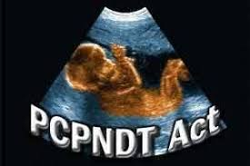
PRE-CONCEPTION AND PRENATAL DIAGNOSTIC TECHNIQUES[PROHIBITION OF
SEX SELECTION] ACT. 1994
DR.SHEEBA .S,
ASSISTANT PROFESSOR,
DEPT OF OBG.

Slide 2
INTRODUCTION
Diagnosis before birth. Methods for prenatal diagnosis include ultrasound of the uterus, placenta, and/or developing fetus; chorionic villus sampling(CVS) to obtain tissue for chromosome or biochemical analysis; and amniocentesis to obtain amniotic fluid for the analysis of chromosomes, enzymes, or DNA. A growing number of birth defects and diseases can be diagnosed prenatally and in some cases treated before birth. Also known as antenatal diagnosis. Prenatal testing consists of prenatal screening and prenatal diagnosis, which are aspects of prenatalcare that focus on detecting problems with the pregnancy as early as possible. These may be anatomic and physiologic problems with the health of the zygote, embryo, or fetus, either before gestation even starts (as in preimplantation genetic diagnosis) or as early in gestation as practicable.

Slide 3
Screening can detect problems such as neuraltube defects, chromosome abnormalities, and gene mutations that would lead to genetic disorders and birth defects, such as spina bifida, cleft palate, Downs Syndrome, Tay–Sachs disease, sickle cell anemia, thalassemia, cystic fibrosis, muscular dystrophy, and fragile X syndrome. Some tests are designed to discover problems which primarily affect the health of the mother, such as PAPP-A to detect pre-eclampsia or glucose tolerance tests to diagnose gestational diabetes. Screening can also detect anatomical defects such as hydrocephalus, anencephaly, heart defects, and amniotic band syndrome. Prenatal diagnosis employs a variety of techniques to determine the health and condition of an unborn fetus. Without knowledge gained by prenatal diagnosis, there could be an untoward outcome for the fetus or the mother or both. congenital anomalies account for 20 to 25% of perinatal deaths.

Slide 4
INDICATIONS FOR PRENATAL DIAGNOSIS
Advanced maternal age
Previous child with chromosome abnormality
Women who are pregnant with multiple
Family history of single gene disorder
Family history of neural tube defect
Family history of other congenital structural abnormality
Abnormality identified in pregnancy
Women who had previously had misscarriage
Other high risk factors[consanguinity,poor obst,maternal illnesses]

Slide 6
Characteristics of serum screening options for aneuploidy
Screening Test | Gestational Age at Screening (in wk) | Detection Rate for Trisomy 21 (%) | Screen Positive Rate (%) | Analytes and/or Measurements Obtained
First-trimester screen | 10–13* | 82–87¹⁵ | 5 | Nuchal translucency Papp-A hCG
Triple screen | 15–22 | 69 | 5 | hCG AFP uE3
Quad screen | 15–22 | 81 | 5 | hCG AFP uE3 DIA

Slide 7
Integrated | 10–13 and 15–22 | 96 | 5 | First-trimester screen, then quad screen
Sequential stepwise | 10–13 and 15–22 | 95 | 5 | First-trimester screen, then quad screen
Contingent screen | 10–13 and 15–22 | 88–94 | 5 | First-trimester screen, then quad screen
Cell-free DNA | Any age after 9 10 wk | 99 | 0.5 | Molecular evaluation of cell-free fetal DNA within maternal serum

Slide 8
"Triple" or "Quadruple" screen
Condition | MSAFP | uE3 | HCG
Neural tube defect | Increased | Normal | Normal
Trisomy 21 | Low | Low | Increased
Trisomy 18 | Low | Low | Low
Molar pregnancy | Low | Low | Very High
Multiple gestation | Increased | Normal | Increased
Fetal death (stillbirth) | Increased | Low | Low

Slide 9
Chromosomal Abnormalities
Maternal Age | Trisomy 21 | Trisomy 18 | Trisomy 13
15 - 19 | 1:1600 | 1:17000 | 1:33000
20 - 24 | 1:1400 | 1:14000 | 1:25000
25 - 29 | 1:1100 | 1:11000 | 1:20000
30 - 34 | 1:700 | 1:7100 | 1:14000
35 - 39 | 1:240 | 1:2400 | 1:4800
40 - 44 | 1:70 | 1:700 | 1:1600
45 - 49 | 1:20 | 1:650 | 1:1500

Slide 10
Risk of aneuploidy by maternal age
Maternal Age at EDD (y) | Risk of Trisomy 21 | Risk of Other Chromosomal Abnormality
20 | 1:1480 | 1:525
25 | 1:1340 | 1:475
30 | 1:940 | 1:384
35 | 1:353 | 1:178
40 | 1:85 | 1:62
45 | 1:35 | 1:18

Slide 11
Incidence of common aneuploidies
Trisomy 21 | 1 in 800 live births
Trisomy 18 | 1 in 7500 live births
Trisomy 13 | 1 in 15,000 live births
Monosomy X (Turner syndrome) | 1 in 5000 girls
Trisomy X | 1 in 1000 girls
XXY (Klinefelter syndrome) | 1 in 1000 boys
XYY | 1 in 1000 boys

Slide 12
Estimated detection rate of cell-free DNA for aneuploidy and positive predictive value by maternal age
 | Pooled Detection Rate²⁰ (%) | PPV at 25 y of Ageª (%) | PPV at 35 y of Ageª (%) | PPV at 45 y of Ageª (%)
Trisomy 21 | 99.2 | 51 | 79 | 98
Trisomy 18 | 96.3 | 15 | 39 | 90
Trisomy 13 | 91.7 | 7 | 21 | Data insufficient to calculate
Monosomy X | 90.3 | 41 | 41 | 41

Slide 18
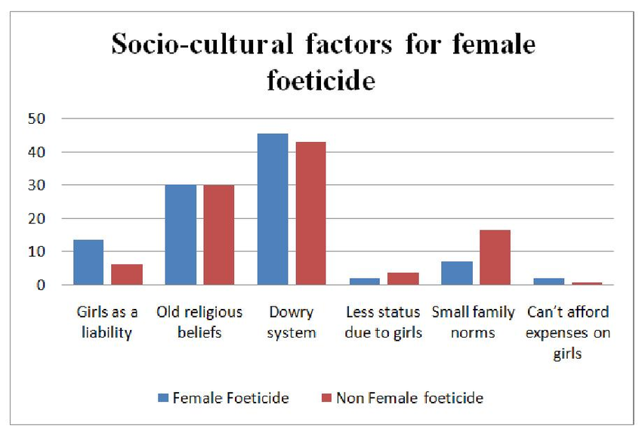

Slide 21
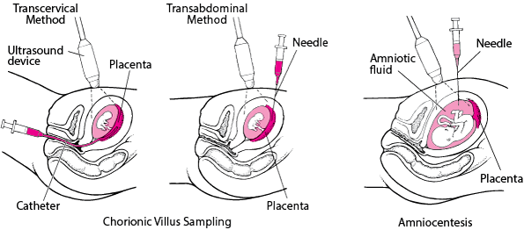
Pre- natal diagnostic test

Slide 23
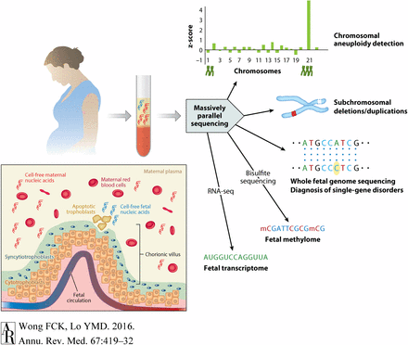
Non invasive pre natal testing to diagnoze the fetal genome

Slide 24
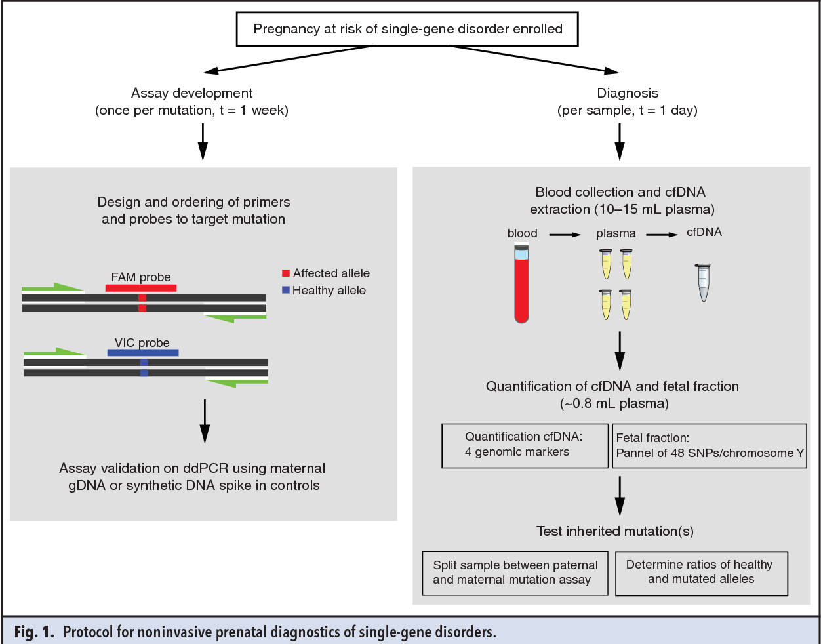

Slide 25
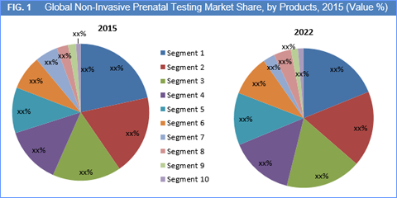

Slide 29
Conduction of pre-natal diagnostic techniques is allowed only for the detection of :
Chromosomal abnormality
Genetic metabolic diseases
Haemoglobinopathies
Sex linked genetic diseases
Inborn anomalies
Other defects or diseases specified by the central

Slide 30
PNDT

Slide 31
PNDT PROCEDURE

Slide 33
CONDITIONS FOR ANALYSIS OR TEST OF PND PROCEDURE

Slide 49
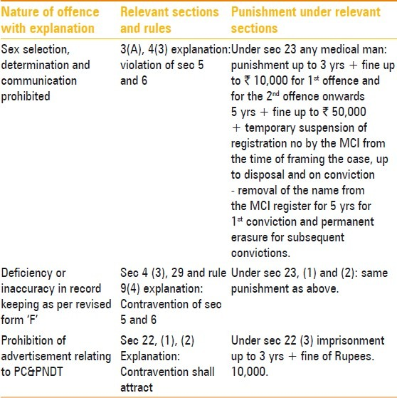

Slide 50
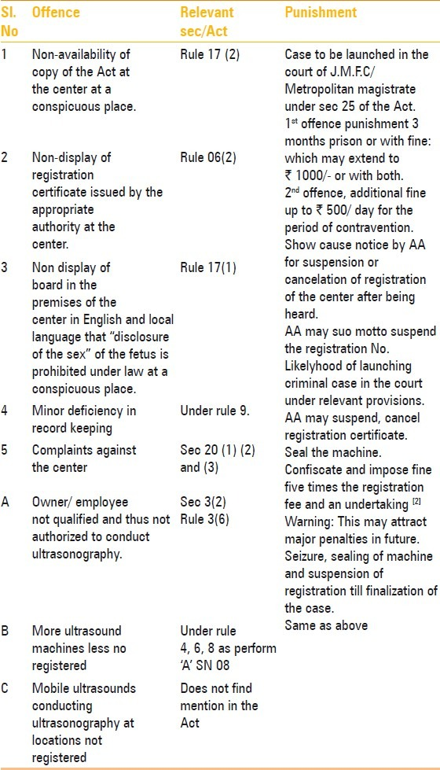
MINOR OFFENCES

Slide 51
COURT WILL TAKE COGNIZANCE OF OFFENCES ON A COMPLAINT

Slide 52
THESE ARE THE COURT CAN TAKE ACTION ON THIS OFFENCES

